Slide 1


Slide 2

FONTS USED:
LOGO: ACLONICA
General: 42DOT SANS

Slide 3


Slide 4


Slide 5


Slide 6
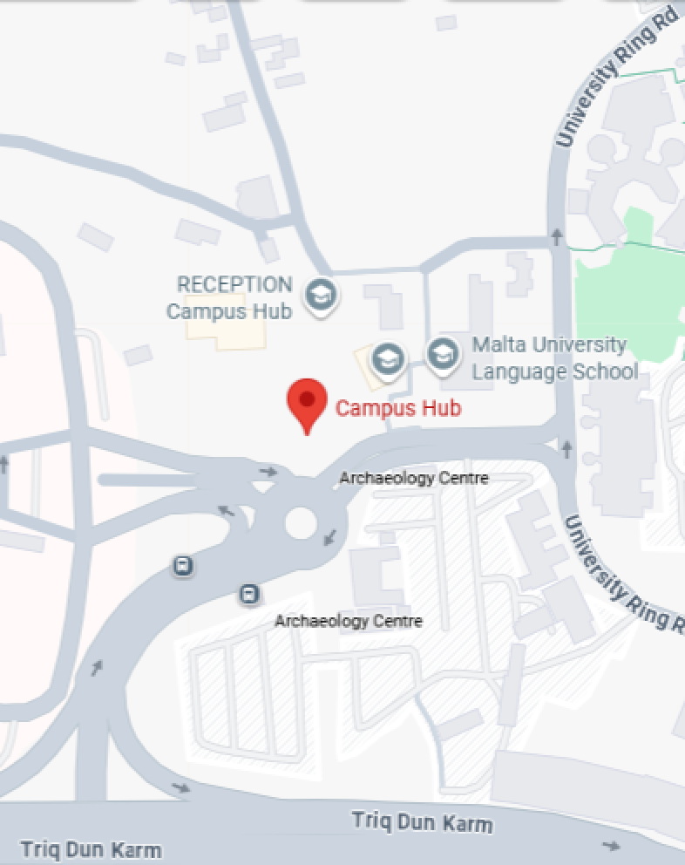

Slide 7
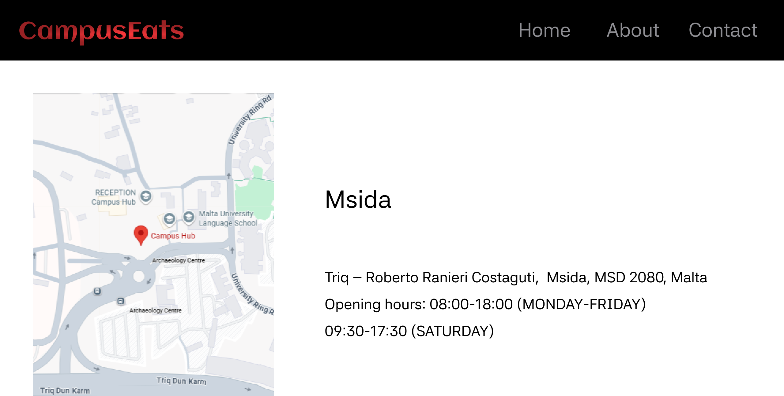

Slide 8


Slide 9
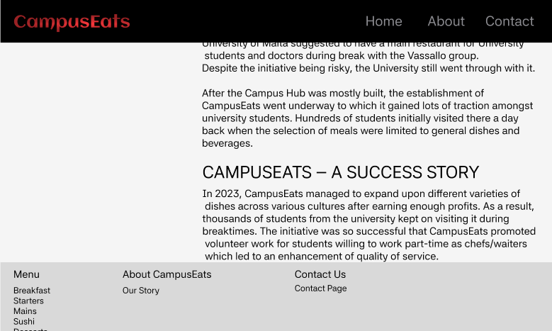

Slide 10
